Slide 1
GUVI Capstone Project
Walmart Superstore Sales Analysis
MBT7
By
G. Arivazhagan

Slide 2

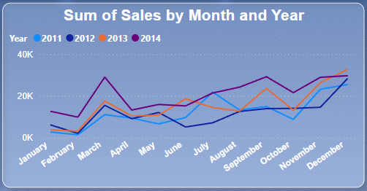
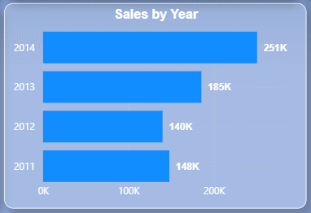
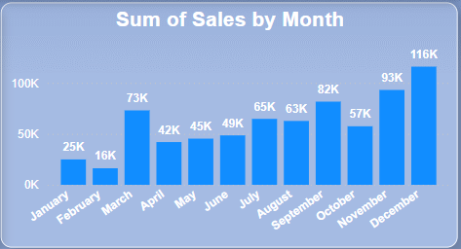
What is Happening
In an Over all view we can see the months March, September, November and December we are having an good improvements in sales
In sales by Year Chart we can see we have Approximately 65.59% increase in sales from 2011 to 2014

Slide 3
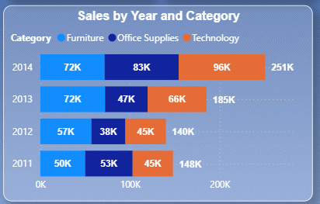
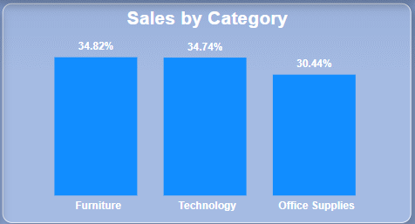
What is Working
In an Over all of Sales by Category view we can see the Furniture is contributing 34.82% of the sales and in 2nd place is technology with 34.74% and in 3rd place we have Office supplies.
From the Sales by year and category chart we can see the break down of category by year
We can see a significant Growth of Technology in 2013 and 2014 where there is no significant difference in Furniture.

Slide 4
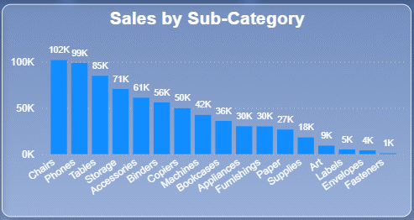
What is Working
Here we can see How each Sub Category is working
From Sales By Sub-Category we can see Chairs Are the top performing Sub-Category
Where Fasteners are the low Performing once.
We will see more details on Sub-Category in Pareto Analysis

Slide 5
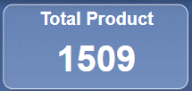
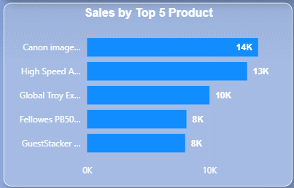
What is Working
Here are our top 5 products by sales from 1509 Products.
Canon image CLASS 2200 Advanced Copier
High Speed Automatic Electric Letter Opener
Global Troy Executive Leather Low-Back Tilter
Fellowes PB500 Electric Punch Plastic Comb Binding Machine with Manual Bind
Guest Stacker Chair with Chrome Finish Legs

Slide 6
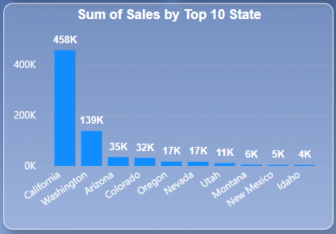
What is Working
In the chart mentioned above, we can observe the top 10 states that are performing well in sales.
Here We can see we are making a good sales in Claifornia.
We will see more details on State in Pareto Analysis

Slide 7
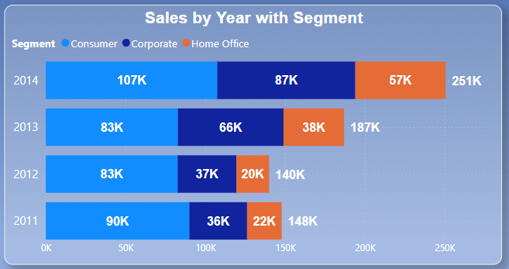
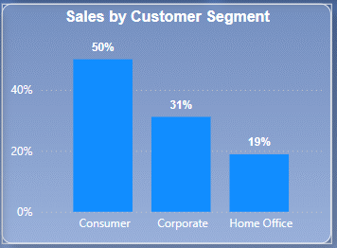
What is Working
Here, we divide our customers into three segments:
Consumer
Corporate
Home Office
Out of these three, consumers contribute around 50% of the sales, followed by Corporate.
When comparing data between 2011 and 2014 (just an observation):
Consumers increased by 18.89%.
Corporate increased by 141.67%.
Home Office increased by 128.0%.

Slide 8
What is Happening
In an Over all view we can see the months March, September, November and December we are having an good improvements in sales
In sales by Year Chart we can see we have Approximately 65.59% increase in sales from 2011 to 2014

Slide 9
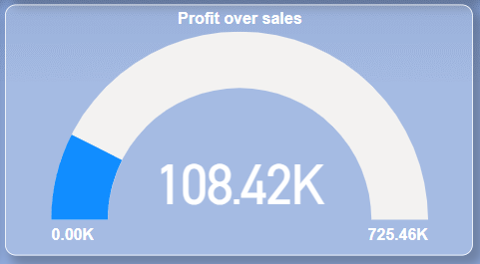
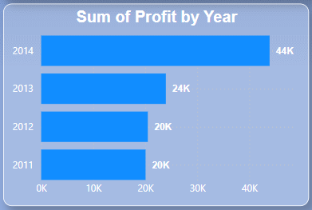
Profit
Here in Profit Over sales we can see we Made Around 725.46K in total sales and made 108.42K in Profit
I short we made approximately 4.02% more Profit from 2014 compared to 2011
Profit percentages for each year ((Sales/profit) X100)
2011 - 13.51%
2012 – 14.29%
2013 - 12.97%
2014 – 17.53%
which show 2014 is the highest among the most Profitable Year compared from 2011
Total sales
Profit

Slide 10
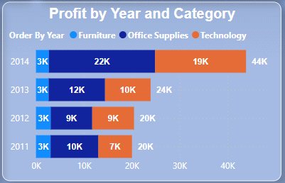
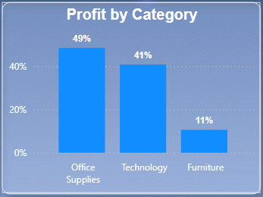
What is Happening
Here we can see the Profit by each Category.
From Profit and category chart we can see 49% of the total profit is from Office supplies and 41% from Technology and the rest from furniture.
If we take a closer look into Profit by Year and category Chart we can notice there is a huge growth from 2013 to 2014 which
90% in Technology.
83.33% in Office Supplies.
And it is important to notice that there is no difference in furniture Category profit even though we are getting 34.82% sales.

Slide 11
What is Happening
Here we can see the Profit by each Category.
From Profit and category chart we can see 49% of the total profit is from Office supplies and 41% from Technology and the rest from furniture.
If we take a closer look into Profit by Year and category Chart we can notice there is a huge growth from 2013 to 2014 which
90% in Technology.
83.33% in Office Supplies.
And it is important to notice that there is no difference in furniture Category profit even though we are getting 34.82% sales.

Slide 12
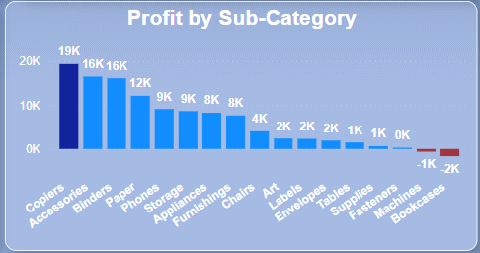
What is Happening
The chart you can see above is showing the Profit made by Each sub category.
We can see Two Sub-category are going in negative value which is clearly indicating profit loss.
We made a sale of 36K in Bookcases but made a -2K in loss as a result, and 42K sales but we made -1K in Machines Sub-Category.
Which shows strong red Signal that indicates something wrong.

Slide 13
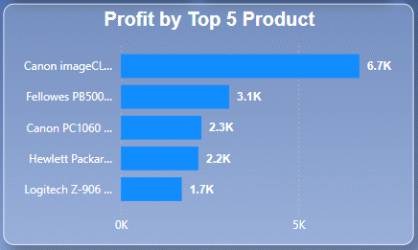
What is Happening
Here are our top 5 products by Profit from 1509 Products.
Canon image CLASS 2200 Advanced Copier
Fellowes PB500 Electric Punch Plastic Comb Binding Machine with Manual Bind
Canon PC1060 Personal Laser Copier
Hewlett Packard LaserJet 3310 Copier
Logitech Z-906 Speaker sys - home theater - 5.1-CH
Here we can see “Canon image CLASS 2200 Advanced Copier” is contributing approximately 6.18% to the over all profit.

Slide 14
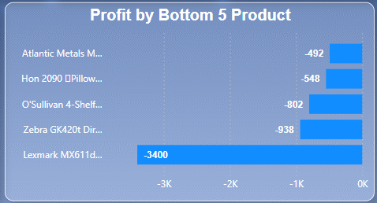
What is Happening
Here are our 5 low Performing products by Profit from 1509 Products. With sub category
Lexmark MX611dhe Monochrome Laser Printer (Machines)
Zebra GK420t Direct Thermal/Thermal Transfer Printer (Machines)
O'Sullivan 4-Shelf Bookcase in Odessa Pine (Bookcases)
Hon 2090 Pillow Soft Series Mid Back Swivel/Tilt Chairs (Chairs)
Atlantic Metals Mobile 4-Shelf Bookcases, Custom Colors(Bookcases)
Here in these 5 products we can see we are seeing loss which is an clear Red signal for our business. That these products need out attention.

Slide 15
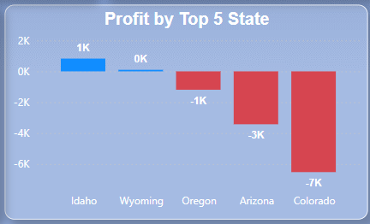
What is Happening
Here are our 5 low Performing state by Profit
Here is an detailed data
Idaho - 4K in sales and 1k in profit (25%)
Wyoming – 1.6k in sales and 100.2 in Profit (6.26%)
Oregon – 17K in sales and -1K in loss (-5.88%)
Arizona – 35K in sales and -3K in loss (-8.57%)
Colorado – 32K in sales and -7K in loss (-21.88%)
Here in Oregon, Arizona, Colorado we can see we are seeing loss which is an clear Red signal for our business, That these states need our attention.

Slide 16
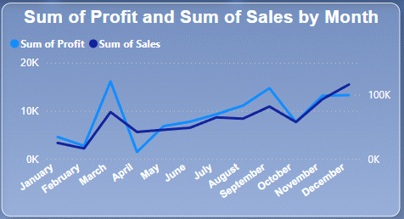
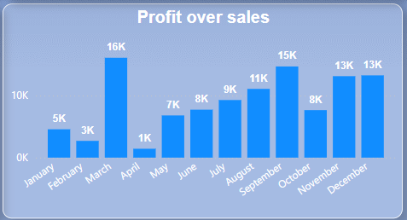
What is Happening
In an Over all view we can see the months March and September are the most Profitable.
Here is an small break down.
March – 25K in sales and 16K in Profit (64%)
September – 82K in sales and 15K in profit (18.29%)
On the down side we have the month April
We made a sales of Rs.42K and made only 1K (2.38%) in profit.

Slide 17
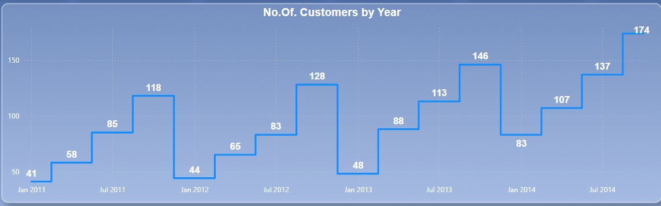
Customers
During Q4, we experience a significant increase in new customers every year.
Conversely, Q1 is the quarter where we receive the fewest new customers each year.
The chart clearly explains that the customer base keeps growing steadily compared to the previous year.

Slide 18
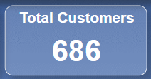
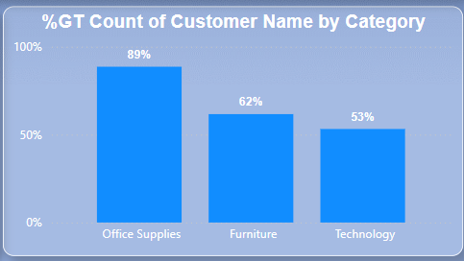
Customers
Here we can see that 89% of our customers are from the Office Supplies category, followed by Furniture and Technology.
If you take a closer look, you'll notice that the percentages in the chart don’t add up. This is because one customer might have purchased items across multiple categories.
It is good to see the customer basket value Spread across different categories, which is a healthy signal for our business.

Slide 19
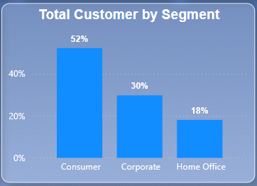
Customers
We can see 52 % of our Customer’s are from Consumers segment followed by Corporate 30% and Home Office 18%
By focusing on the specific needs and preferences of each customer segment, we can drive more conversions and improve overall sales.

Slide 20
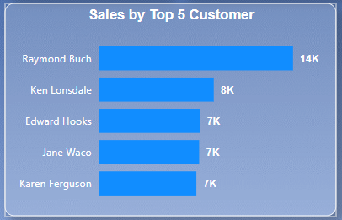
Customers
Here we have the Top 5 Customers based on sales
We can contact these customers to ask about their shopping experience and identify areas for improvement or new Products they might be looking for to enhance their experience.
It is recommended to offer a coupon if the customer provides feedback.
While the top 5 customers may not be a large enough sample, their insights can help us estimate how many additional surveys we need to conduct to gather more comprehensive feedback.

Slide 21
Pareto Analysis (80:20 Rules)
The Pareto Principle is based on the Presumption that a relatively small number of inputs (20%) have most impact on the results/output (80%).

Slide 22
Our Approach
Using pareto Analysis We analyze the following to get a better clarity
State,
Customer,
Sub-Category.

Slide 23
Advantages of applying Pareto Analysis State
Identify Top Performers: Shows which states contribute the most to sales.
Focus Efforts: Helps you target marketing and sales efforts in states with the highest impact.
Resource Allocation: Ensures you spend time and money in states where you get the most sales.
Spot Weaknesses: Highlights states with low sales, so you can find and fix issues.
Boost Sales: By focusing on high-impact states, overall sales can increase more effectively

Slide 24
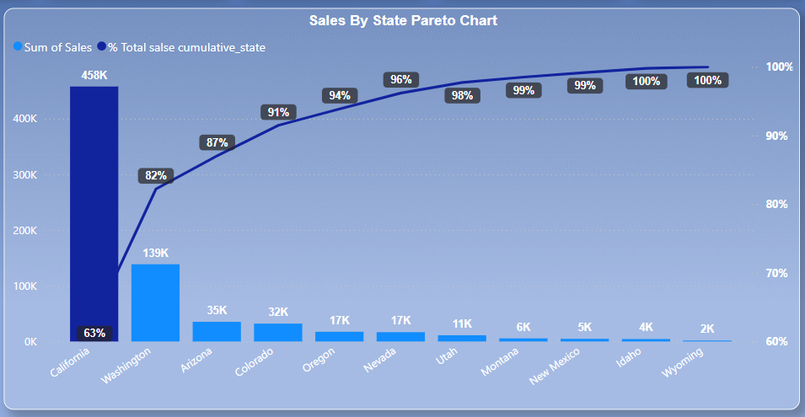
In the chart above, we can clearly see that California is the highest contributor in sales.
Therefore, it is recommended to allocate considerable resources to California.
Additionally, it is recommended to apply the Five Whys technique to understand underlying issues.
Gather customer feedback for better improvement.

Slide 25
Advantages of applying Pareto Analysis Customer
Identify Key Issues: Helps you find the main problems that affect most customers.
Improve Satisfaction: Focuses on fixing big issues, making more customers happy.
Efficient Service: Uses resources to solve the most common customer problems first.
Better Understanding: Gives clear insights into what customers care about the most.
Increase Loyalty: Addressing major concerns can lead to more loyal customers

Slide 26
Advantages of applying Pareto Analysis Customers

Slide 27
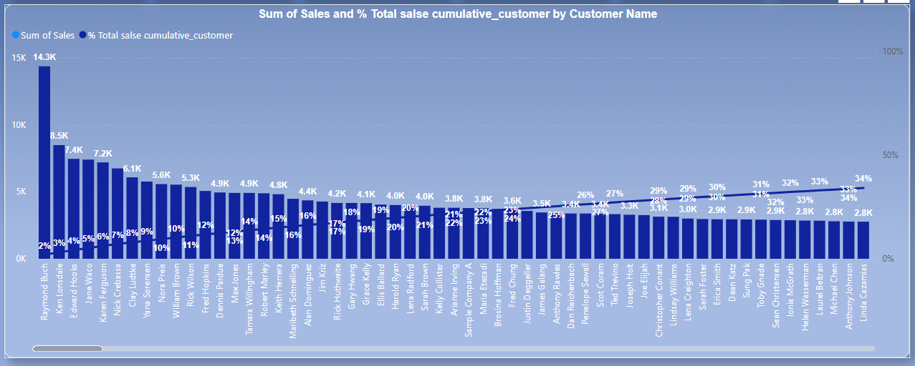
In the chart above, we can see a Huge number of customers Who are contributor the highest in sales.
We can try contacting a few of the customers and collecting feedback for better improvement
And it is advised to give coupons for the customers who would like to give feedback.
Following these Steps we can Find Fix a few Issues.

Slide 28
Advantages of applying Pareto Analysis Sub-Category
Focus on Important Issues: Helps you find and work on the most important parts that cause most problems or benefits.
Use Resources Wisely: Makes sure you spend time and money on the parts that matter the most.
Make Better Decisions: Turns complex data into simple information to help you decide what to do next.
Get More Done: Fixing the big issues first leads to faster and bigger improvements.
Solve Problems Effectively: Helps you fix the main causes of problems in a way that lasts longer.

Slide 29
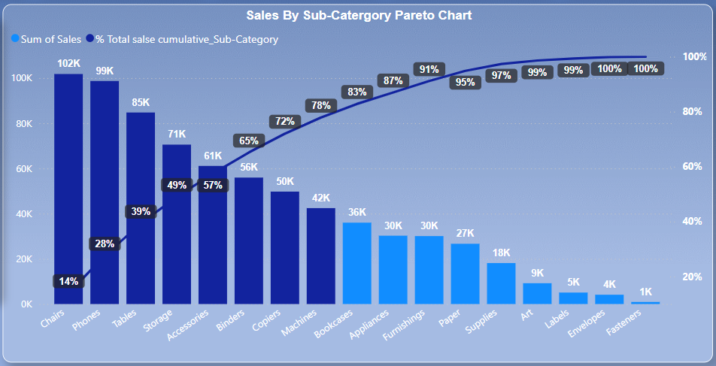
In the chart above, we can see that Chairs, Phones, Tablets, storages, accessories, Binders, Copiers and machine contributor in sales.
Therefore, it is recommended to allocate considerable resources to California.
Additionally, it is recommended to apply the Five Whys technique to understand underlying issues.
Gather customer feedback for better improvement.

Slide 30
Sales Analysis
Improve customer satisfaction : Sales analysis can help businesses understand what customers want and why they buy, which can help build deeper bonds with the target audience.
Adjust sales strategy: Sales performance analysis can provide insights that help businesses adjust their sales strategy and improve results.
Improve decision-making : Consistent sales analysis data can help support the sales decision-making process.
Inventory management: By analyzing sales we can have a clear look at each product's sales and will help us to make the correct decisions when it comes to inventory storage.
New Ides For Marketing: sales trends will help us find out the new ways for promotions and budgeting decisions

